Slide 1
ETC Programmer Workshop 2
Finite State Machines (FSM)
By Terri Lim

Slide 2
Pre-requisites
You should already be somewhat familiar with Unity.
I expect you to know what Object-Oriented Programming is.
This isn’t intro to programming.
You should understand what are C# delegates, or at least the concept of function pointers.
If you don’t, watch this video first.
Slides & Unity examples can be found here.
https://github.com/TypeDefinition/ETC-Programmer-Workshops

Slide 3
What is a FSM?
But why do I want to use it?
Almost everything can be a state machine.
A gun is a state machine.
An enemy AI is a state machine.
A game manager is a state machine.
You are a state machine.
Your friends are state machines.
Your fish is a state machine.
Think of it as a glorified switch-case.

Slide 4
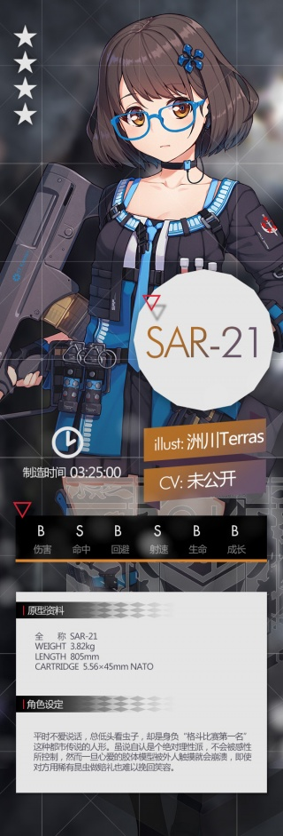
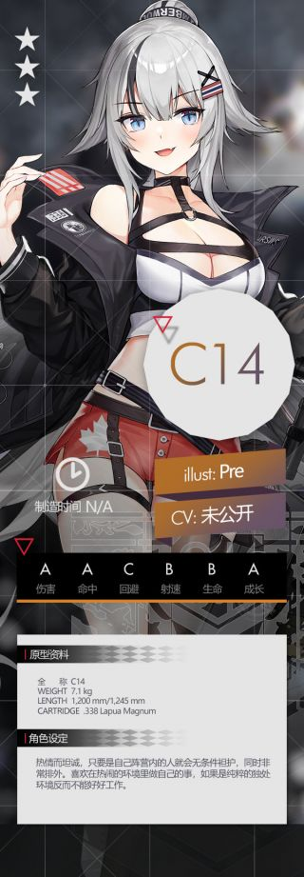
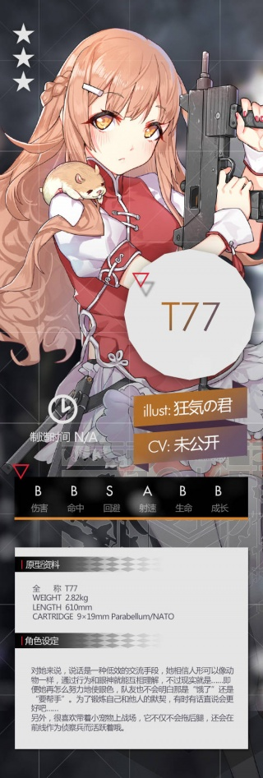
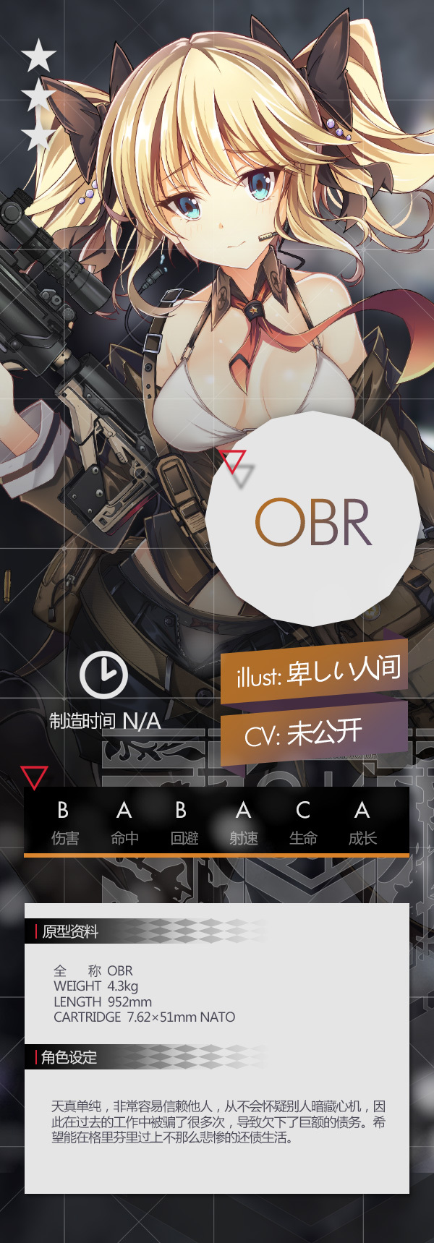

Example 1 - Guns Go Pew Pew!
So you want to make a shooter game.
Sucks to be you, it’s the one thing you can’t do in BVW.
That’s why I’m using it our main example.

Slide 5

Things to consider when programing a gun.
Is it shooting?
Is it reloading?
Is the gun out of ammo?
Can it shoot while reloading?
Can it shoot when there’s no bullets?
And many more…

Slide 6
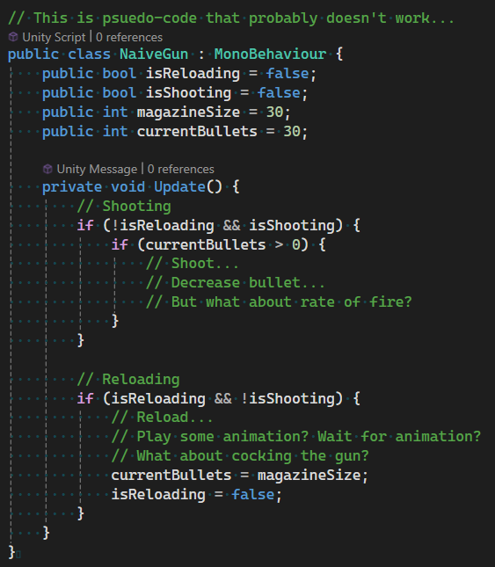
Let’s use some booleans!
Lots of if-statements.
Gets complicated very quickly.
It’s hard to understand.
It’s hard to extend.
It’s just terrible.
I know some of you have done this for BVW Round 1.
For your sanity, please don’t do this.

Slide 7

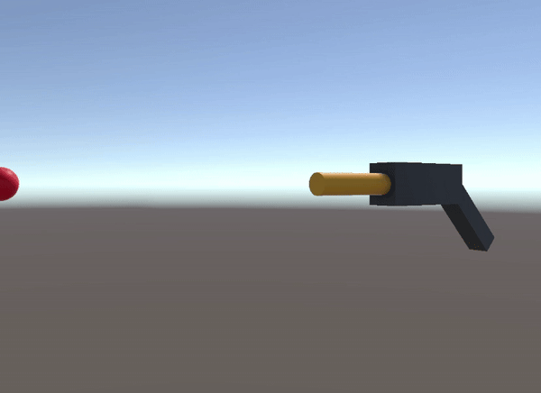
Why not break it down into states?
(Just 3 for now.)
SEMI-AUTO
FULL-AUTO
RELOAD

Slide 8
What does a state have?
Enter
Update
Late Update
Exit

Slide 9
FSM Controls State Transitions
Finite State Machine
State B
State A
State D
State C

Slide 10
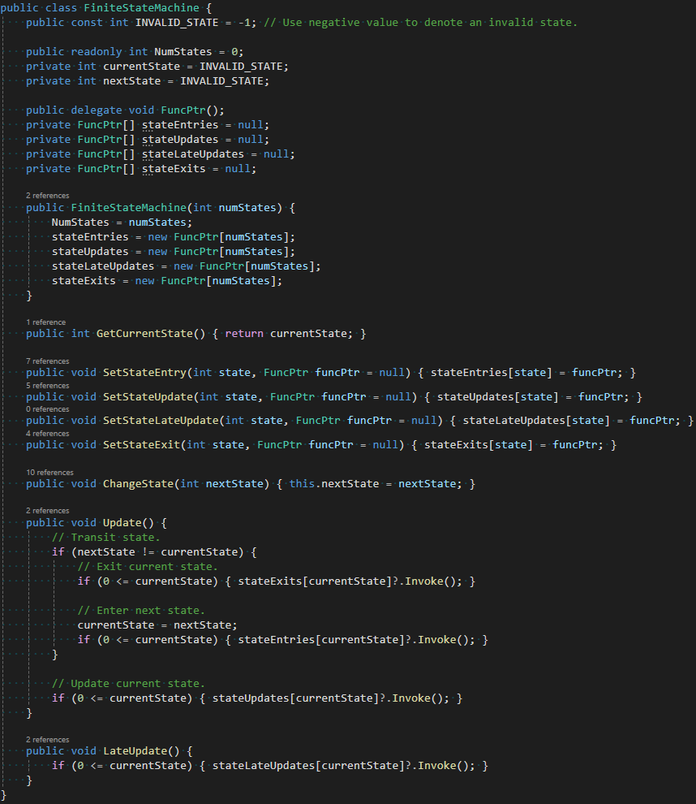


FSM Code

Slide 11

Live Demo In Unity…

Slide 12
What else can be finite state machines?

Slide 13

Example 2 - Racing Game
Alrighty, no guns. Let’s make a racing game!
Racing games tend to have distinct states. FSM is suited for the game manager.
Countdown
Race
End

Slide 14


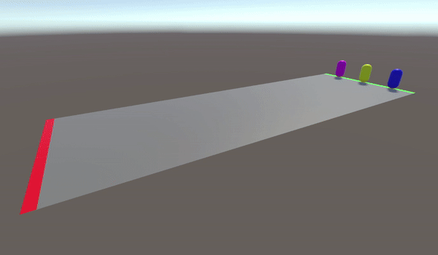
Race States
COUNTDOWN
Countdown
Spawn all players at start line.
Players cannot move.
Show countdown UI.
Race
Allow players to move.
End
Display results.
RACE
END

Slide 15
Many more things can be finite state machines!

Slide 16
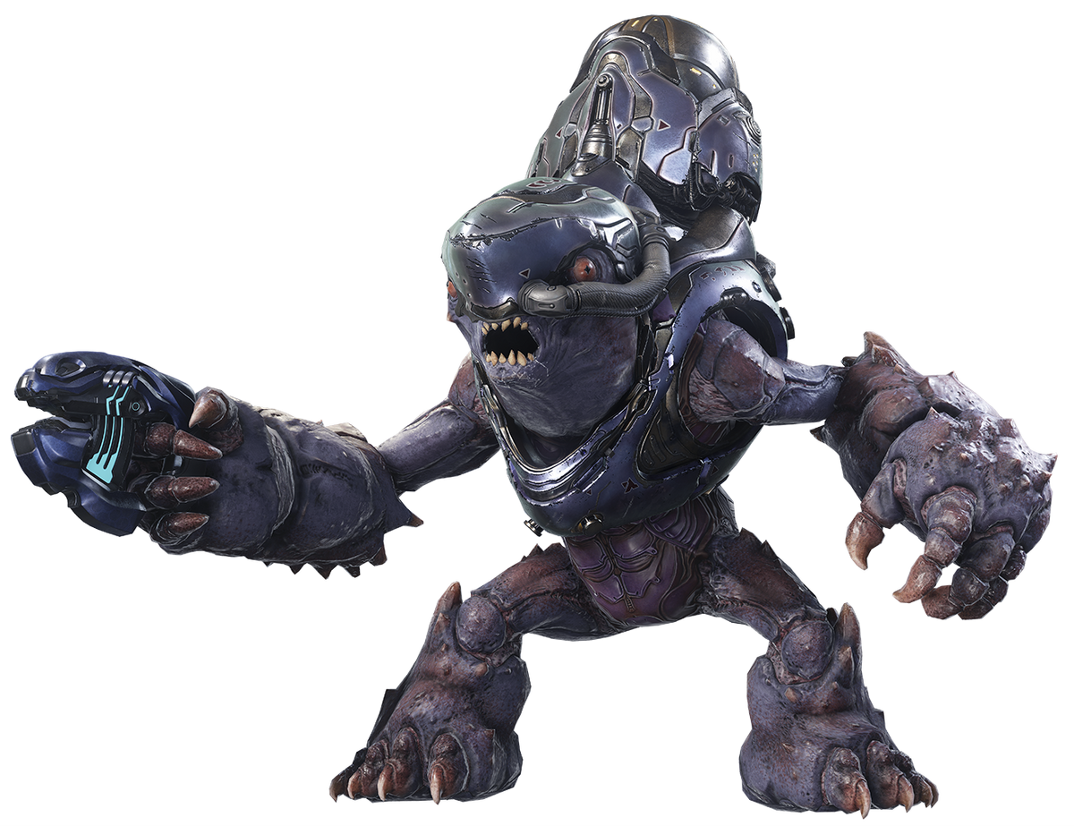
Enemy AI
IDLE
CHASE
DEAD
ATTACK

Slide 17

Open World Player
DRIVING
WALKING
DEAD
FLYING

Slide 18

Romance Love Interest
DISLIKE
NEUTRAL
DEAD
LOVE

Slide 19
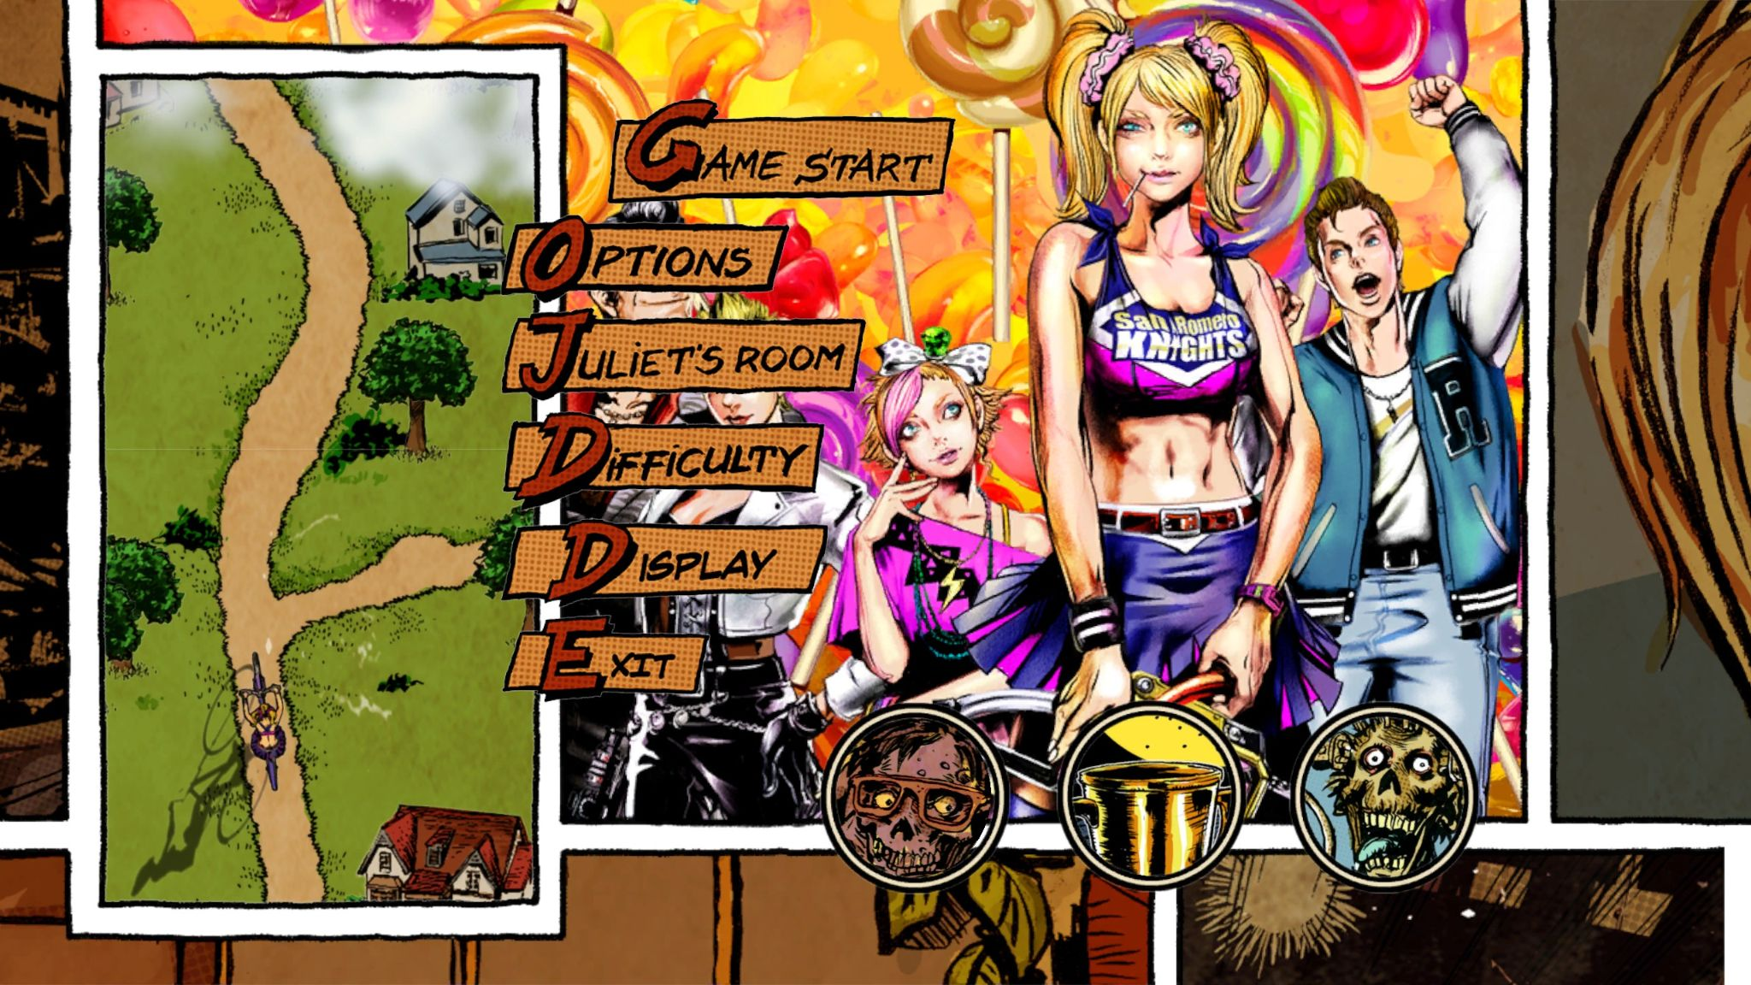
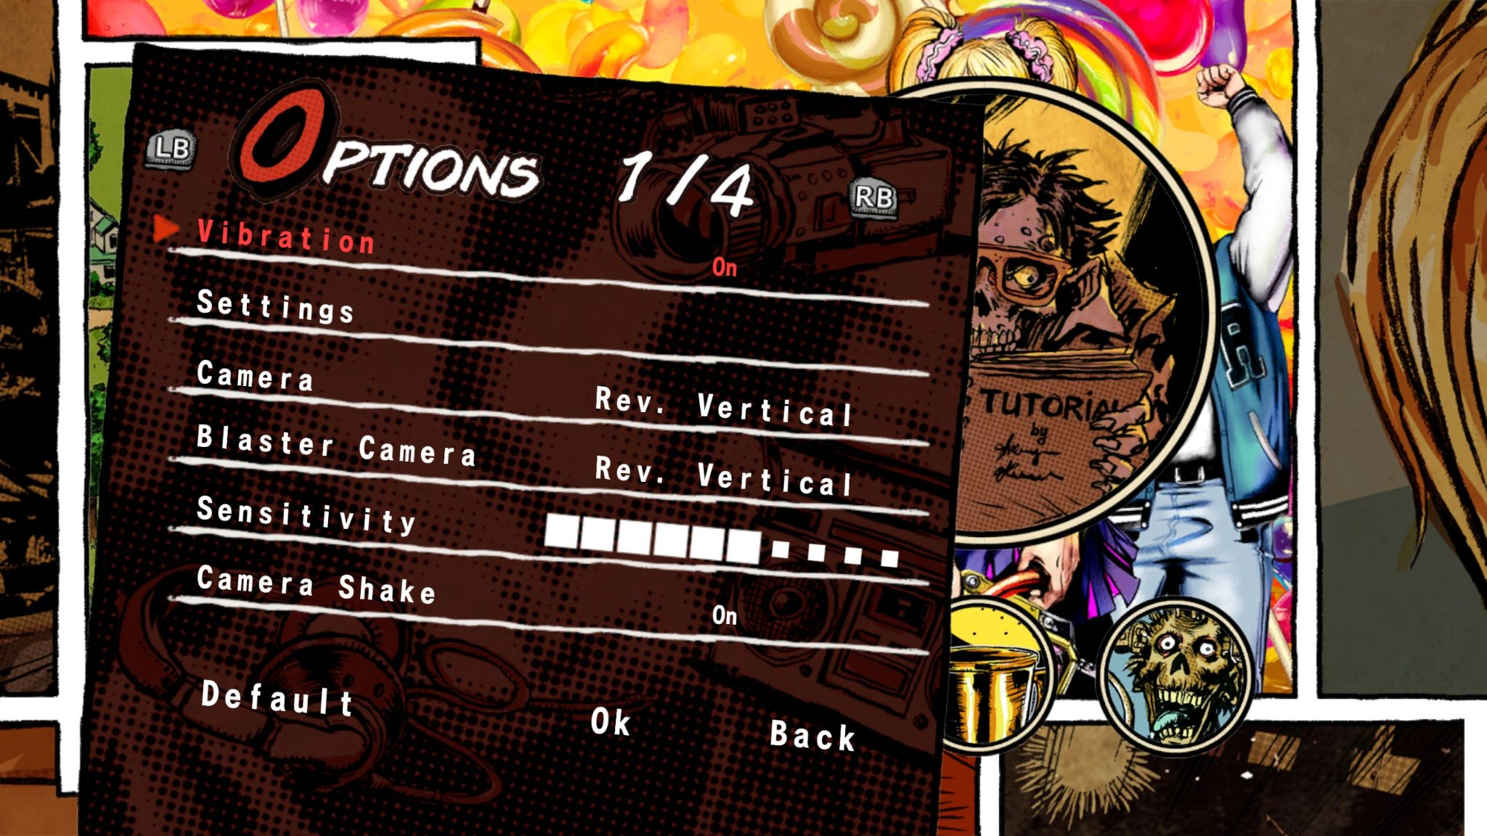
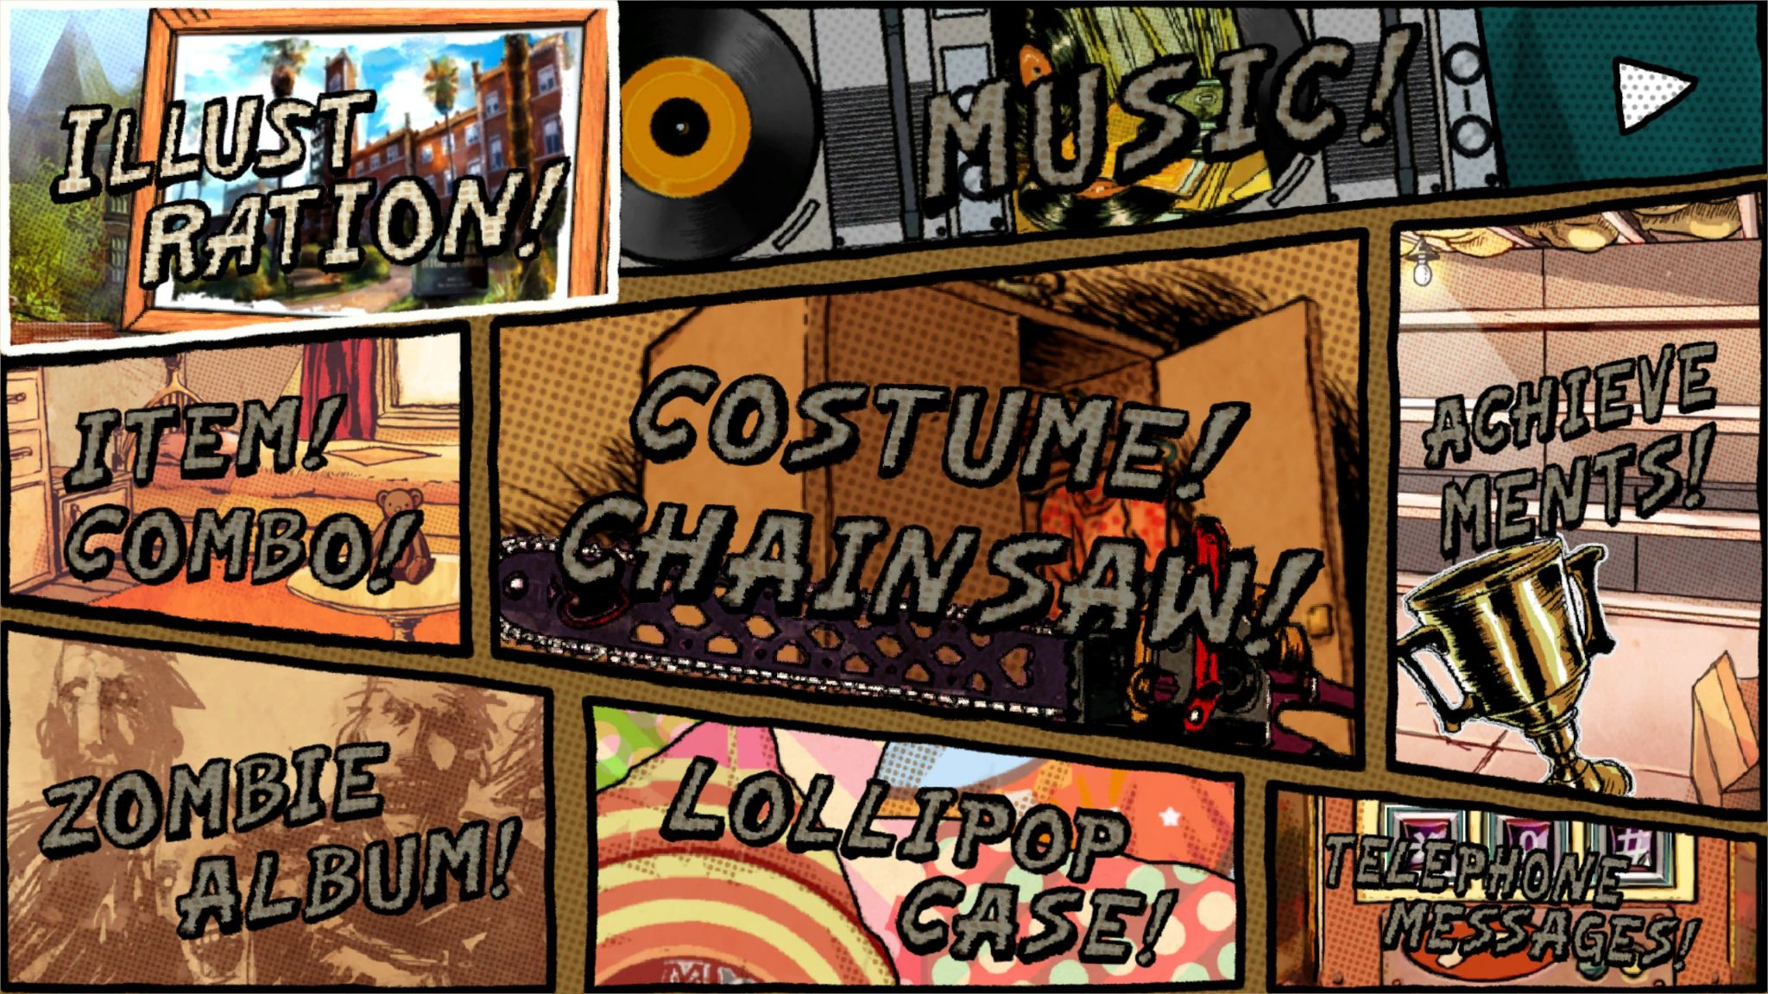
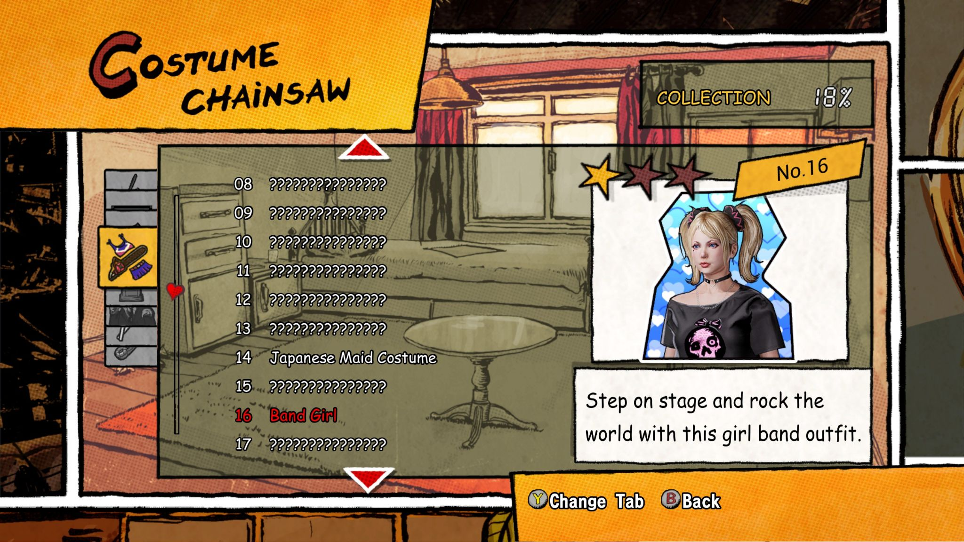
Game Menus

Slide 20
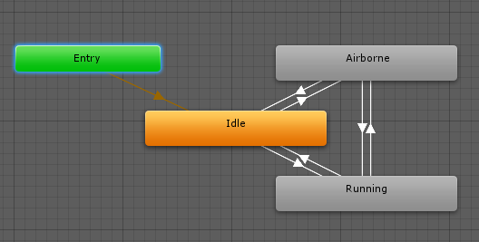
Animations

Slide 21
Fin.
Want to learn more game AI stuff?
Check out behaviour trees!
Images from Girls Frontline, Umamusume, Halo, Saints Row, Doki Doki Literature Club, Lollipop Chainsaw, and Unity Game Engine.

